Slide 1





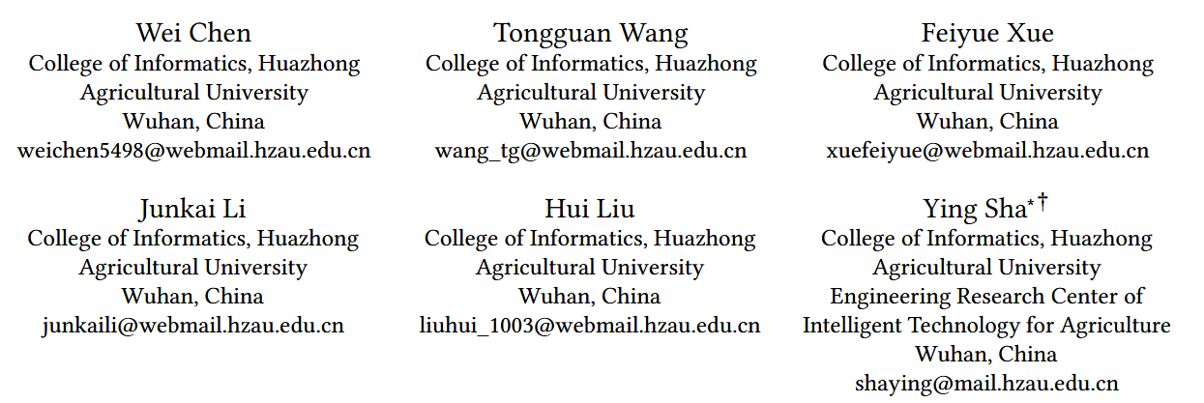





ATAI
Advanced Techniqueof Artificial Intelligence
ATAI
ChongqingUniversity _{AdvancedTechniqueof}
of Technology Artificial Intelligence
Chongqing University of
Technology
Chongqing University ^{ATAI}
_{of Technology} Advanced Techniqueof
Artificial Intelligence
Chongqing University of Technology
Chongqing University of Technology
Beyond Words: Enhancing Desire, Emotion, and Sentiment Recognition with Non-Verbal Cues
Code:https://github.com/especiallyW/SyDES
——WWW_2026
Reported by HongLiang Nie
1

Slide 2

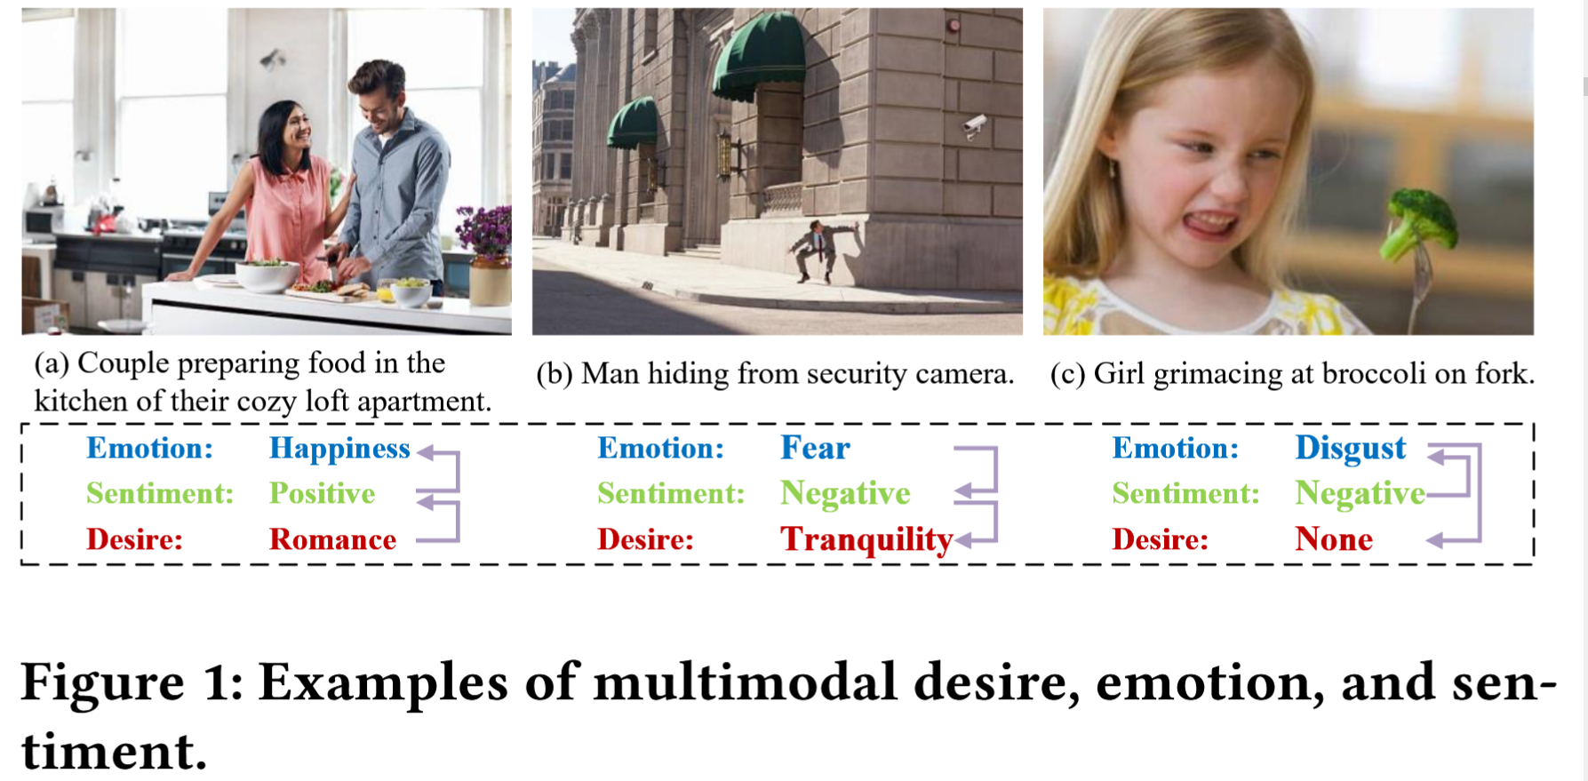
ATAI
AdvancedTechniqueof
Artificial Intelligence
ATAI
ChongqingUniversity _{AdvancedTechniqueof}
of Technology Artificial Intelligence
ChongqingUniversity of Technology
Motivation
existing methods in multimodal emotion and sentiment recognition still predominantly focus on enhancing verbal cues , treating image-based non-verbal cues merely as auxiliary features to be extracted and fused superficially. This underutilization constitutes a fundamental limitation.
Notes:
因为不同模态（比如图片和文字）的数据长得太不一样了，规模也不一样，表达的意思精细程度也不一样，所以很难把它们强行捏在一起去处理。

Slide 3

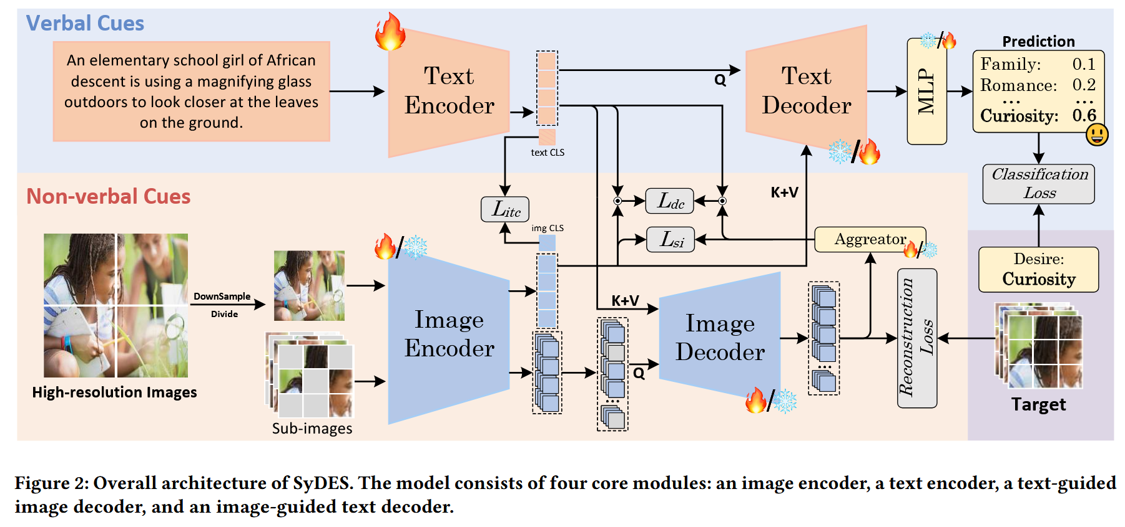
ChongqingUniversity of Technology
ATAI
AdvancedTechniqueof
Artificial Intelligence
ATAI
ChongqingUniversity _{AdvancedTechniqueof}
of Technology Artificial Intelligence
Overview

Slide 4
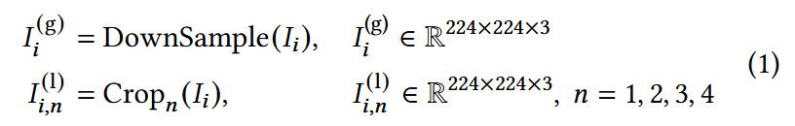
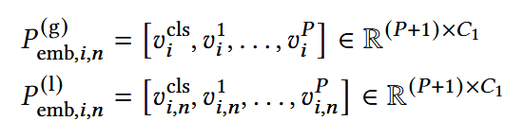





ChongqingUniversity of Technology
ATAI
AdvancedTechniqueof
Artificial Intelligence
ATAI
ChongqingUniversity _{AdvancedTechniqueof}
of Technology Artificial Intelligence
Method

Slide 5

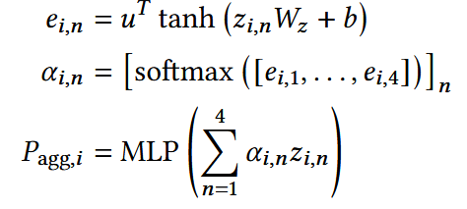

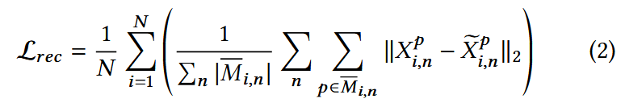
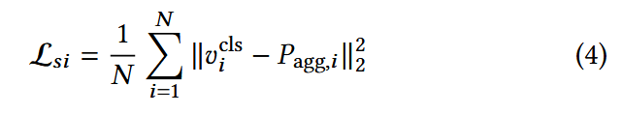
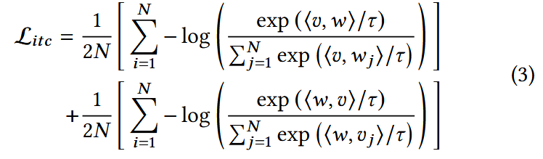
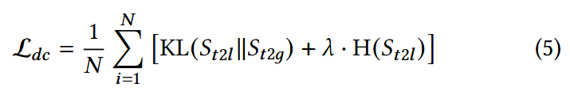

ChongqingUniversity of Technology
ATAI
AdvancedTechniqueof
Artificial Intelligence
ATAI
ChongqingUniversity _{AdvancedTechniqueof}
of Technology Artificial Intelligence
Method

Slide 6

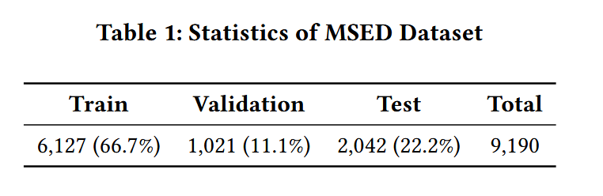
ATAI
AdvancedTechniqueof
Artificial Intelligence
ATAI
ChongqingUniversity _{AdvancedTechniqueof}
of Technology Artificial Intelligence
ChongqingUniversity of Technology
Experiments

Slide 7
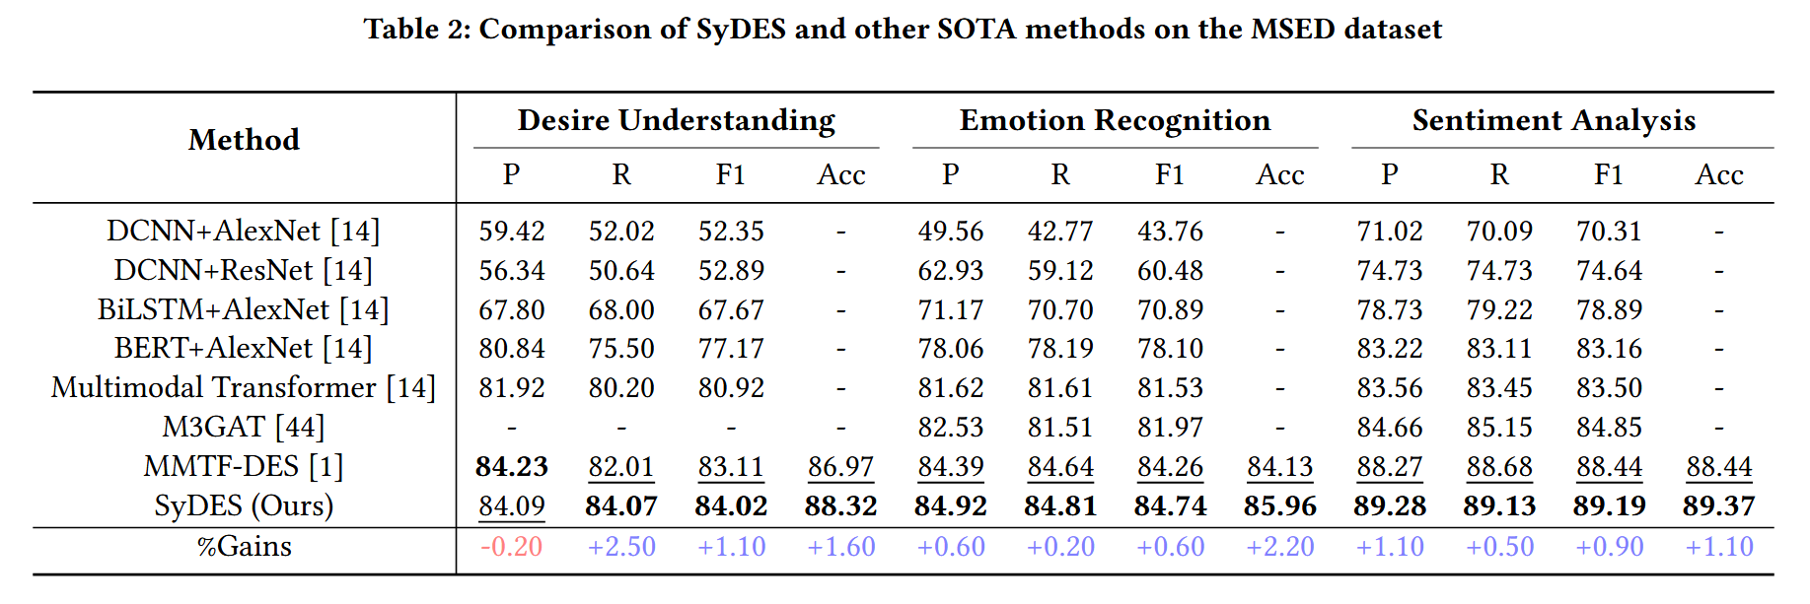
ATAI
AdvancedTechniqueof
Artificial Intelligence
ATAI
ChongqingUniversity _{AdvancedTechniqueof}
of Technology Artificial Intelligence
ChongqingUniversity of Technology
Experiments

Slide 8
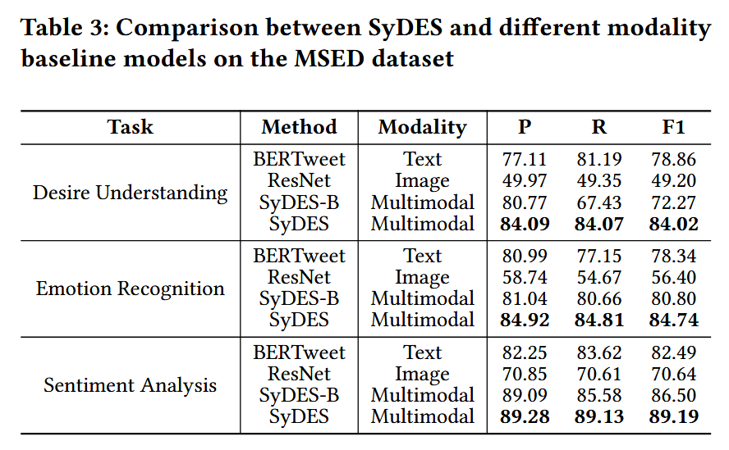
ATAI
AdvancedTechniqueof
Artificial Intelligence
ATAI
ChongqingUniversity _{AdvancedTechniqueof}
of Technology Artificial Intelligence
ChongqingUniversity of Technology
Experiments

Slide 9
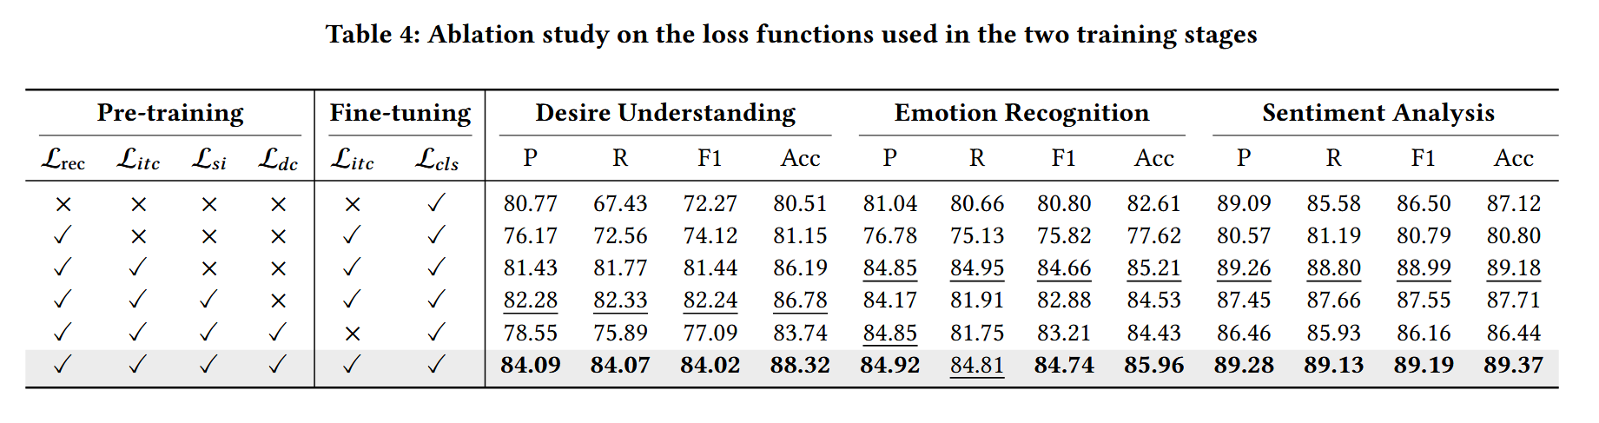
ATAI
AdvancedTechniqueof
Artificial Intelligence
ATAI
ChongqingUniversity _{AdvancedTechniqueof}
of Technology Artificial Intelligence
ChongqingUniversity of Technology
Experiments

Slide 10
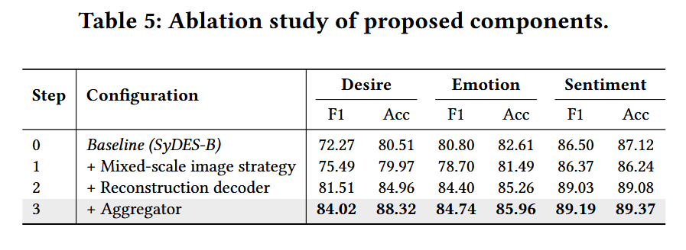
ATAI
AdvancedTechniqueof
Artificial Intelligence
ATAI
ChongqingUniversity _{AdvancedTechniqueof}
of Technology Artificial Intelligence
ChongqingUniversity of Technology
Experiments

Slide 11
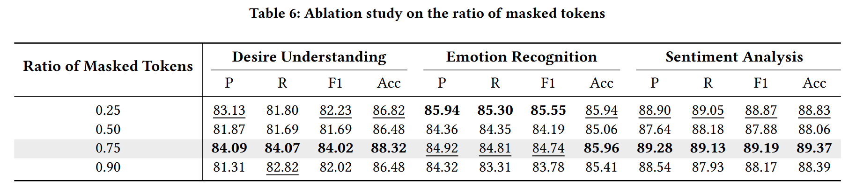
ATAI
AdvancedTechniqueof
Artificial Intelligence
ATAI
ChongqingUniversity _{AdvancedTechniqueof}
of Technology Artificial Intelligence
ChongqingUniversity of Technology
Experiments

Slide 12
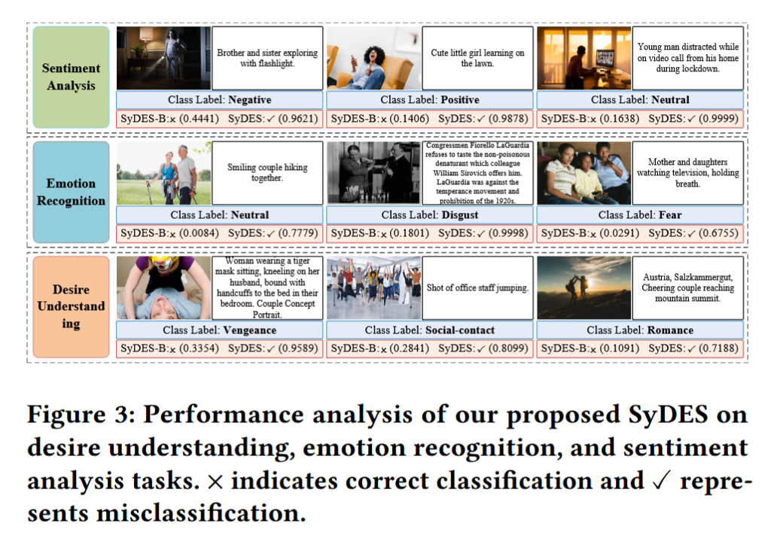
ATAI
AdvancedTechniqueof
Artificial Intelligence
ATAI
ChongqingUniversity _{AdvancedTechniqueof}
of Technology Artificial Intelligence
ChongqingUniversity of Technology
Experiments

Slide 13
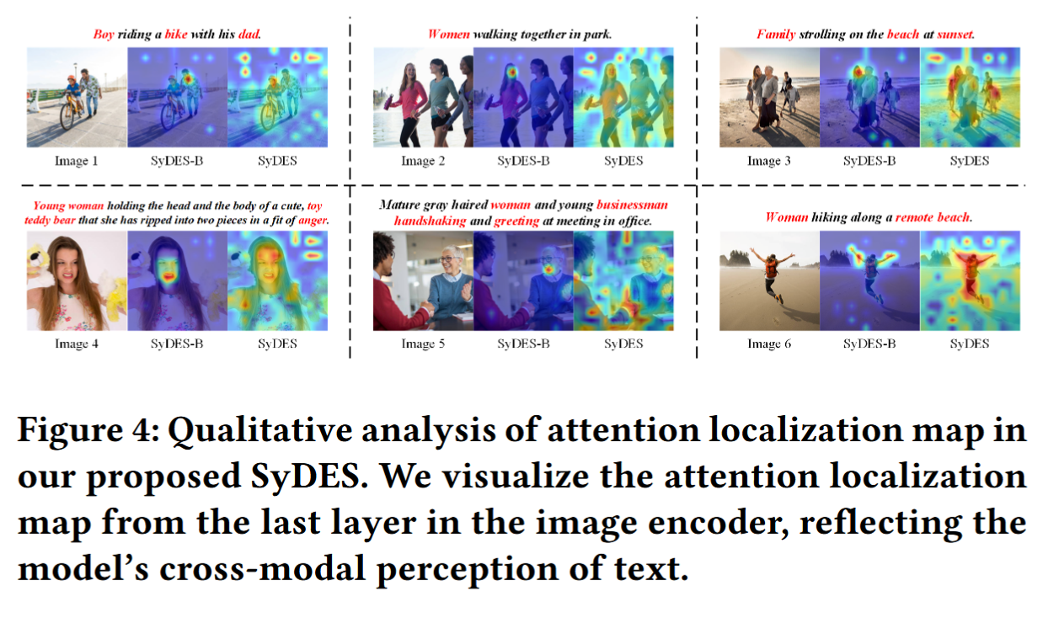
ATAI
AdvancedTechniqueof
Artificial Intelligence
ATAI
ChongqingUniversity _{AdvancedTechniqueof}
of Technology Artificial Intelligence
ChongqingUniversity of Technology
Experiments

Slide 14
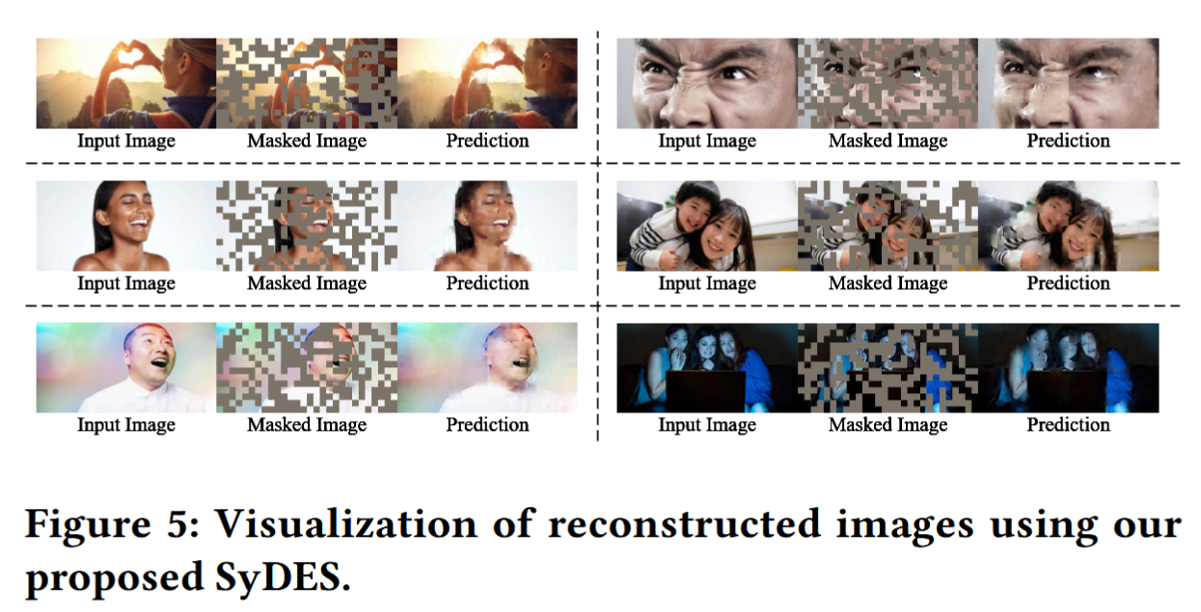
ATAI
AdvancedTechniqueof
Artificial Intelligence
ATAI
ChongqingUniversity _{AdvancedTechniqueof}
of Technology Artificial Intelligence
ChongqingUniversity of Technology
Experiments

Slide 15


ChongqingUniversity of Technology
ATAI
AdvancedTechniqueof
Artificial Intelligence
ATAI
ChongqingUniversity _{AdvancedTechniqueof}
of Technology Artificial Intelligence
Thanks!

